Slide 1

Sant Shiromani Ravidas Global Skills Park
Bhopal - Madhya Pradesh
Department of
Advance Electronics Mobile Device & IOT Integration
A MINI PROJECT REPORT
ON
Heart beat monitering system
Submitted by :
Pankaj uikey - SSRGSP/ELX/2025/2/037 Jitendra chopda - SSRGSP/ELX/2025/2/028 Aman Rathor - SSRGSP/ELX/2025/2/004
Hemant shakywar - SSRGSP/ELX/2025/2/020
Krishan kumar - SSRGSP/ELX/2025/2/030
Gulshan sarathe - SSRGSP/ELX/2025/2/019
Pankaj gupta - SSRGSP/ELX/2025/2/036
Sivraj singh - SSRGSP/ELX/2025/2/045
Akash sharma - SSRGSP/ELX/2025/2/001
Dhun singh thakur - SSRGSP/ELX/2025/2/016
Submitted to :
Guided by: - Mr. Gaurav Sharma
Trainer (ELX Dept.) SSRGSP Bhopal [M.P.]
MR. Alok Ranjan Course Head (ELX Dept.) SSRGSP Bhopal [M.P.]
DATE: - 02/03/2026

Slide 2
INDEX
ATBSTRAC
3.
ACKNOWLEDGEMENT
4.
1. INTRODUCTION
5.
2. OBJECTIVE
6.
3. METHODOLOGY
7.
8.
SYSTEM DESIGN
Key Components
Power Supply Section
ADC- - - - - - - - - - - - - - - - - - - - - - - - - - - - - - - - - - - 11.
Heart beat monitering
5. PCB DESIGN SECTION
8-10.
11.
11.
12.
13.
14.
15.
6. WORKING PRINCIPLE
7. IMPLEMENTATION
8. LEARNING OUTCOME
9. ADVANTAGES & APPLICATIONS---------------------------- 16.
10.CONCLUSION
16.
11.REFERENCES
17.

Slide 3
ABSTRACT
Heart Beat Monitoring System is a healthcare-based project designed to measure and monitor a person's heart rate in real time. The system uses a heartbeat sensor to detect pulse signals from the human body and processes the data through a microcontroller. The measured heart rate is displayed on a screen and can be continuously monitored for any abnormal changes. This system helps in the early detection of irregular heartbeats and provides quick information about a person's cardiovascular condition. It is especially useful for patients, elderly individuals, athletes, and healthcare professionals who require regular heart rate monitoring. The project is cost-effective, easy to use, and portable, making it suitable for both home and clinical environments. By providing accurate and real-time heart rate data, the Heart Beat Monitoring System contributes to improved health monitoring and preventive healthcare practices.

Slide 4
ACKNOWLEDGEMENT
Heart Beat Monitoring System is a healthcare monitoring project developed to measure and track a person's heart rate accurately in real time. The system uses a heartbeat sensor to detect pulse signals generated by the human body and converts them into readable data.
Heart Beat Monitoring System is a healthcare monitoring project developed to measure and track a person's heart rate accurately in real time. The system uses a heartbeat sensor to detect pulse signals generated by the human body and converts them into readable data.
Heart Beat Monitoring System is a healthcare monitoring project developed to measure and track a person's heart rate accurately in real time. The system uses a heartbeat sensor to detect pulse signals generated by the human body and converts them into readable data.
The project is designed to be portable, cost-effective, and easy to operate. Due to its simple design and reliable performance, it can be used in homes, clinics, hospitals, and fitness centers for continuous heart rate monitoring and health management.
The project is designed to be portable, cost-effective, and easy to operate. Due to its simple design and reliable performance, it can be used in homes, clinics, hospitals, and fitness centers for continuous heart rate monitoring and health management.

Slide 5
1. INTRODUCTION
Heart Beat Monitoring System is an important healthcare monitoring solution that helps measure and observe a person's heart rate in real time. The heartbeat rate is one of the most significant indicators of a person's health condition, as it reflects the functioning of the cardiovascular system. Regular monitoring of heart rate can help in the early detection of various heart-related problems and can assist in maintaining overall health.
With the advancement of sensor technology and embedded systems, heart rate monitoring has become more accurate, portable, and affordable. A Heart Beat Monitoring System typically uses a heartbeat sensor to detect pulse signals from the human body. These signals are then processed by a microcontroller, which calculates the heart rate in beats per minute (BPM) and displays the result on a screen or monitoring device.
The system is widely used in hospitals, clinics, fitness centers, and home healthcare applications. It is particularly beneficial for patients with heart conditions, elderly individuals, athletes, and people who require continuous health monitoring. Real-time monitoring enables users and healthcare professionals to take immediate action if any abnormal heart rate patterns are detected.
The main objective of this project is to develop a reliable, cost-effective, and user-friendly heart rate monitoring system that provides accurate measurements and supports preventive healthcare. By offering continuous monitoring and quick access to vital health information, the system contributes to improved patient care and better health management.

Slide 6
2. OBJECTIVE
To design and develop a system capable of measuring heart rate accurately in real time.
To monitor and display the heartbeat rate in beats per minute (BPM) using a heartbeat sensor and microcontroller.
To provide continuous observation of heart activity for health monitoring purposes.
To detect abnormal heart rate conditions and help in the early identification of potential cardiovascular problems.
To develop a portable, user-friendly, and cost-effective monitoring device that can be used in homes, hospitals, and clinics.
To improve healthcare management by providing quick and reliable heart rate information.
To reduce the need for frequent manual pulse checking and increase monitoring efficiency.
To promote preventive healthcare by enabling regular heart rate monitoring and timely medical attention when required.

Slide 7
METHODOLOGY
The methodology of the Heart Beat Monitoring System begins with the collection of pulse signals from the human body using a heartbeat sensor. The sensor is placed on the fingertip or any suitable body part where blood flow can be easily detected. As blood circulates through the veins, the sensor captures variations in blood volume and generates corresponding electrical signals.
The generated signals are then transmitted to a microcontroller for processing. The microcontroller receives the analog signals from the heartbeat sensor and converts them into digital data. It analyzes the pulse signals and calculates the heart rate in terms of beats per minute (BPM).
After processing the data, the calculated heart rate is displayed on an LCD or other display module. This enables users to view their heart rate instantly and continuously. The display provides a simple and effective way to monitor cardiovascular activity in real time.
The system continuously monitors the heartbeat and updates the displayed BPM value at regular intervals. If the heart rate falls below or rises above the normal range, the system can be configured to generate an alert or warning signal, allowing timely attention to potential health issues.
Finally, the entire system is tested under different conditions to ensure accuracy, reliability, and proper functioning. The collected results are analyzed and compared with standard heart rate measurements to evaluate the performance of the Heart Beat Monitoring System.

Slide 8
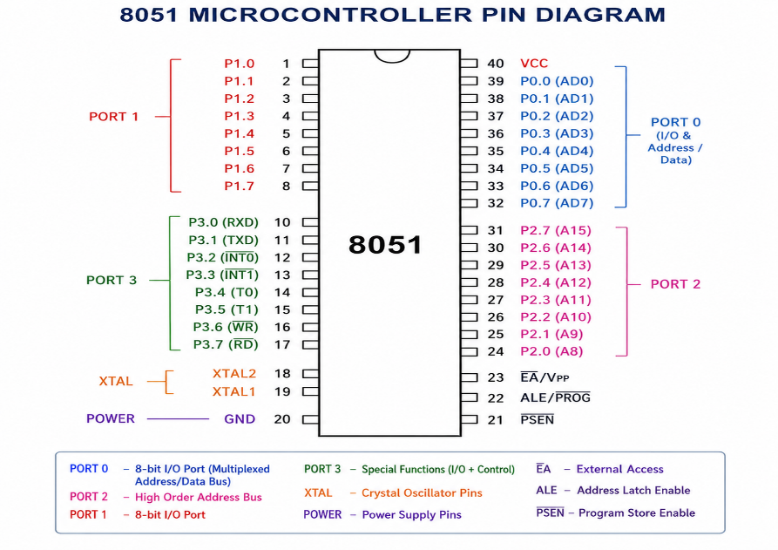
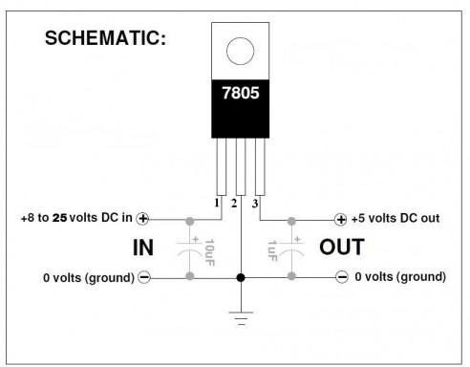
SYSTEM DESIGN
Key Components
The 8051 microcontroller consists of a CPU, memory (RAM and ROM), I/O ports, timers/counters, serial communication interface, and an interrupt system. These components work together to process data, control peripherals, and execute embedded applications efficiently.
7805 Voltage Regulator IC
This component provides a stable +5V DC output from a higher input voltage source. It ensures that the timer IC and other components receive a constant and safe operating
voltage.
Fig 2:7805 Voltage Regulator IC

Slide 9
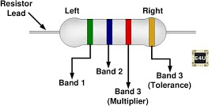


Resistors
Resistors are used to control current flow in the circuit and form part of the timing network. They determine the charging and discharging rate of the capacitor, which directly affects the output frequency.
Fig 3: Resistors
Capacitor
The capacitor is the main timing element. It repeatedly charges and discharges between specific voltage levels, causing the timer IC to switch its output state and generate a square wave.
Fig 4: Capacitor
LED
The LED indicates the presence of power supply in the circuit. It glows when the circuit is powered ON.
Fig 5: LED

Slide 10
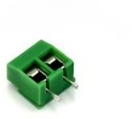
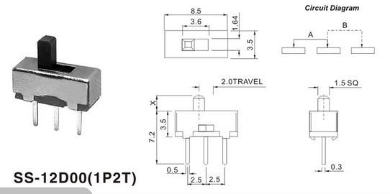
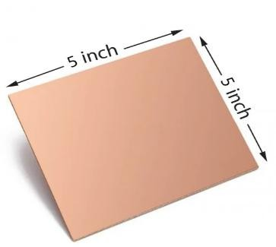
Molex Connector
The Molex connector is used for providing a reliable external connection for power input or output signals. It ensures secure and detachable wiring, making the circuit easy
to connect, disconnect, and maintain.
Fig 6: Molex Connector
Switch
The switch is used to control the power supply to the circuit. It allows the user to turn the system ON or OFF safely without disconnecting the power source.
Fig 7: Switch
PCB Board
The PCB board provides a stable base for mounting all components and ensures proper
electrical connections through copper tracks. It reduces wiring complexity and improves the overall reliability of the circuit.
Fig 8: PCB Board

Slide 11
The system design of the Radar Surveillance System consists of three main sections:
Power Supply Section
The power supply section provides a stable DC voltage required for proper circuit operation. A DC input supply is given to a 7805-voltage regulator IC, which converts the input voltage into a constant +5V regulated output. Capacitors are used to filter noise and stabilize the voltage. An LED with a resistor acts as a power indicator to show the presence of supply. This section ensures reliable and stable power for the timer IC and other components.
3. Crystal Oscillator
A crystal oscillator is used to generate accurate clock signals for the 8051 microcontroller. It determines the operating speed and timing of all internal operations. In the 8051, the crystal is connected between the XTAL1 and XTAL2 pins. A commonly used crystal frequency is 11.0592 MHz, which is suitable for serial communication applications.

Slide 12
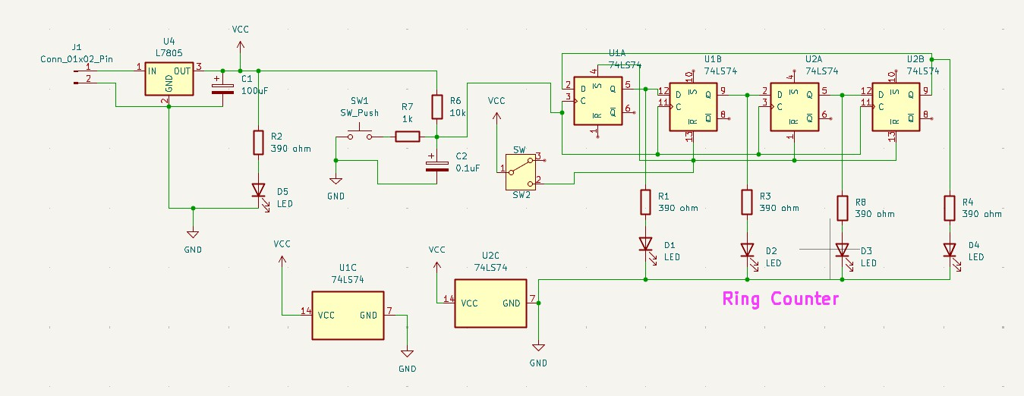
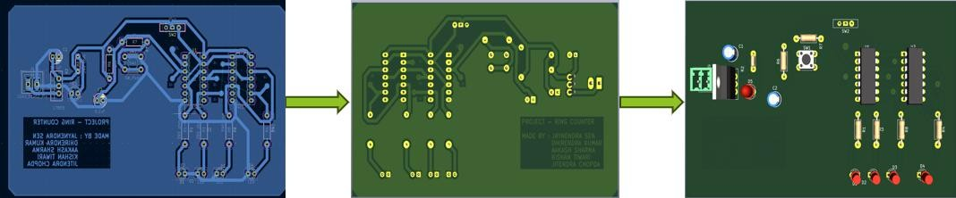
Fig 9: Power Supply, Clock Generation & Ring Counter Section
5. PCB Design Section
After designing the circuit schematic, the PCB layout was created using KiCad software. Proper placement of components and routing of tracks were ensured to avoid short circuits and maintain a compact design. The PCB layout was printed on GSM paper using a laser printer and then transferred onto the copper side of a PCB board. After transferring the design, holes were drilled at component positions. Finally, all electronic components were placed on the board and soldered to complete the hardware assembly.
Fig 10: PCB Layout
Fig 11: 3D Bottom View of PCB
Fig 12: 3D Front View of PCB

Slide 13
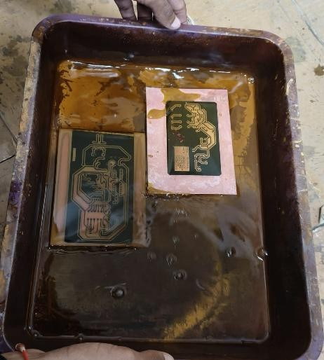

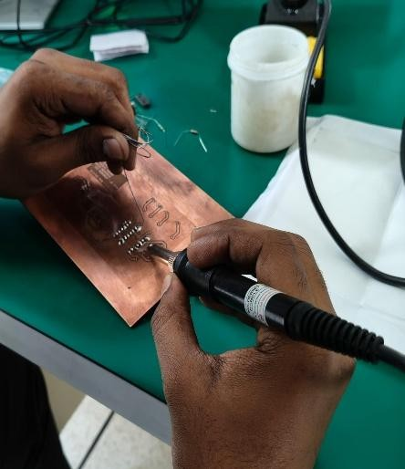
Fig 13: Etching
Fig 14: Drilling
Fig 15: Component Soldering
6. Working Principle
The working principle of the ring counter is based on the sequential shifting of a single logic ‘1’ through multiple D flip-flops connected in a closed-loop configuration. In this project, the ring counter is implemented using the 74LS74, a positive edge-triggered D flip-flop. The flip- flop transfers the logic level present at its D input to the Q output only at the rising edge of the clock pulse, and the output remains stable until the next clock signal.
For proper operation, initialization is required. Initially, one flip-flop is set to logic ‘1’ using the preset input, while the remaining flip-flops are reset to logic ‘0’ using the clear inputs. This establishes the correct starting condition for circulating a single logic bit within the loop.
The Q output of each flip-flop is connected to the D input of the next flip-flop, and the output of the last flip-flop is fed back to the first, forming a closed ring structure. Since all flip-flops share a common clock signal, the circuit operates synchronously, meaning all state changes occur simultaneously at each clock pulse.
With every clock pulse, the logic ‘1’ shifts from one flip-flop to the next in sequence (e.g., 1000 → 0100 → 0010 → 0001 → repeat). LEDs connected to the outputs provide a visual indication of this shifting pattern. Thus, the ring counter produces a continuous sequential output based on synchronous shifting of a single logic bit.

Slide 14
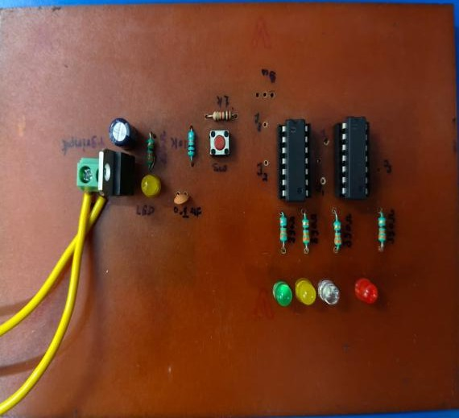
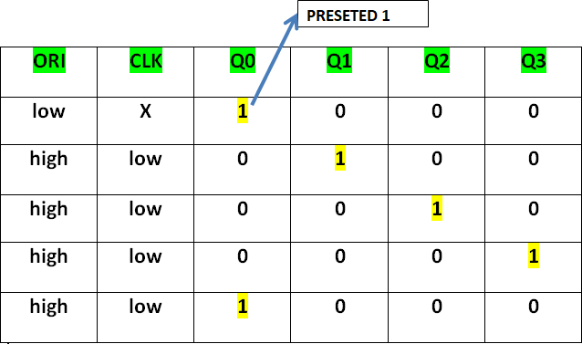
Fig 16: Actual Hardware
Fig 17: Outcome
7. IMPLEMENTATION
The project was developed through a systematic process including circuit design, PCB layout preparation, hardware assembly, and testing. Initially, the 4-bit synchronous ring counter circuit was designed using 74LS74 D flip-flop ICs. Essential components such as resistors, LEDs, capacitors, a 7805-voltage regulator, push button switch, connectors, and IC sockets were selected. A regulated power supply section was designed to convert 9–12V DC input into a stable +5V DC suitable for TTL logic ICs.
The schematic and PCB layout were created using KiCad software. All power and ground connections were properly assigned, and a common clock line was connected to ensure synchronous operation. The Q output of each flip-flop was connected to the D input of the next flip-flop, with the last output fed back to the first to form the ring structure. LEDs with current- limiting resistors were connected to the outputs for visual indication.
After finalizing the PCB layout, the design was printed on GSM paper and transferred onto a copper-clad PCB using the toner transfer method. The board was etched to remove unwanted copper, followed by drilling holes for component mounting. All components were then placed and soldered carefully, using IC sockets to protect the flip-flops from heat damage.
Finally, the circuit was tested by applying DC power and generating clock pulses using the push button. The sequential glowing of LEDs confirmed the correct working of the synchronous ring counter.

Slide 15
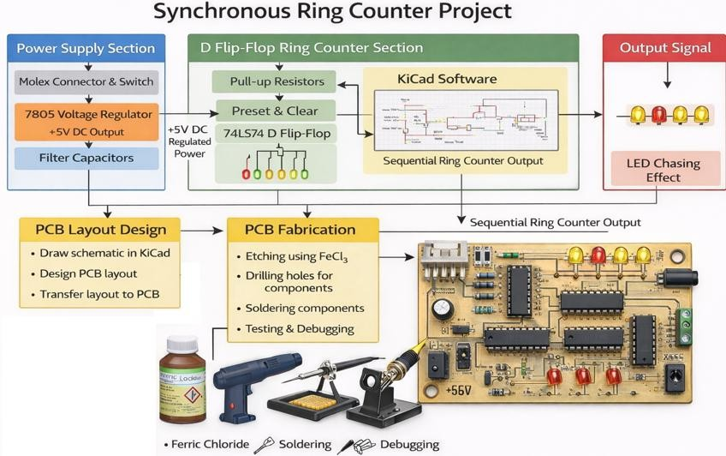
Fig 18: Project Implementation Block Diagram
8. LEARNING OUTCOME
Through this project, a clear understanding of the working principle of a synchronous ring counter using 74LS74 D flip-flop ICs was gained, including how clock pulses control the shifting of logic levels from one flip-flop to the next. The role of preset and clear inputs in initializing the counter was properly understood, along with the concept of feedback connection that forms the ring structure. The project enhanced knowledge of sequential digital circuits, clock synchronization, and practical applications of ring counters in digital systems.
Hands-on experience was developed in schematic creation and PCB layout design using KiCad software. Practical skills were also gained in PCB fabrication processes such as layout printing, toner transfer onto copper board, etching using Ferric Chloride, drilling, component placement, and soldering. Additionally, the project improved testing, debugging, and troubleshooting abilities, especially in identifying wiring errors, checking regulated power supply output, and verifying sequential LED operation.
Overall, the project provided complete exposure to real-time digital hardware development, starting from circuit design to final implementation and testing of a working synchronous ring counter system.

Slide 16
9. ADVANTAGES & APPLICATIONS
Advantages | Applications
Provides accurate and real-time heart rate measurement | Used in hospitals and clinics for patient monitoring
Helps in the early detection of abnormal heart conditions | Helps doctors and nurses track patients' heart conditions
Improves healthcare management and patient safety | Used in home healthcare systems for regular health monitoring
Easy to understand and implement | Educational laboratory experiments
10. CONCLUSION
The Heart Beat Monitoring System is an effective and reliable solution for measuring and monitoring heart rate in real time. The system uses a heartbeat sensor and a microcontroller to accurately detect pulse signals and calculate the heart rate in beats per minute (BPM). The measured values are displayed instantly, allowing users to continuously monitor their cardiovascular health.
This project demonstrates how modern sensor technology can be used to develop a low-cost, portable, and user-friendly healthcare device. It helps in the early detection of abnormal heart rate conditions and supports timely medical attention when required. The system is suitable for use in hospitals, clinics, fitness centers, and home healthcare environments.
Overall, the Heart Beat Monitoring System contributes to improved health monitoring, patient safety, and preventive healthcare. The successful implementation of this project proves its usefulness as a practical tool for real-time heart rate monitoring and health management.

Slide 17
11. REFERENCES
https://www.saveledgered.com/product-p-736646.html
[Accessed: 20 February 2026]
https://www.electrical4u.com/what-is-resistor/ [Accessed: 20 February 2026]
https://www.electrical4u.com/led-or-light-emitting-diode/ [Accessed: 20 February 2026]
https://roboticsdna.in/product/2-pin-126-series-green-connector-for-pcb-screw- terminals/
[Accessed: 20 February 2026]
https://techdelivers.com/copper-clad-fr1-phenolic-pcb-single-sided-5x5-inch-1-2mm- 35-micron-diy-etching-prototyping-electronics-laminate-circuit-board
[Accessed: 20 February 2026]
https://www.build-electronic-circuits.com/7400-series-integrated-circuits/74hc74- 74ls74/
[Accessed: February 26, 2026].
https://www.rmcybernetics.com/shop/electronic-components/mini-slide-switch-spdt- 0-5a
[Accessed: February 26, 2026].

